Slide 1
Churn Data analysis By Using Excel, Power Bi and python.
Course Name – Data analytics
Cohort : DAB15
DSS-STDJUN24520
Presentation By Tanay

Slide 2
Project analysis slide 2
Introduction
Customer churn is a critical business metric that helps companies understand how many customers are leaving over a given period. Analyzing churn is essential for businesses to identify reasons for customer attrition and develop strategies to retain them.
Churn Analysis Important
Helps businesses understand why customers leave.
Enables proactive customer retention strategies.
Reduces acquisition costs by improving customer satisfaction.
Directly impacts revenue growth and profitability.

Slide 3
Overview
Excel for Churn Analysis
🔹 Cleaning and organizing data 🔹 Using formulas (SUMIF, COUNTIF) to calculate churn rates 🔹 Creating pivot tables and charts for trends
2. Power BI for Churn Analysis
🔹 Importing data and transforming it 🔹 Creating interactive dashboards to track churn trends 🔹 Visualizing churn across different customer segments
3. Python for Churn Prediction
🔹 Using Pandas for data manipulation 🔹 Exploratory Data Analysis (EDA) with Matplotlib & Seaborn

Slide 4
Dataset Description for Churn Analysis
To perform a churn analysis, we need a dataset that contains information about customers, their behaviors, and whether they have churned. The dataset typically consists of various attributes that help us understand customer retention patterns.
1. Data Source & Format
The dataset can come from different sources like databases (SQL), or CSV files.
The format is usually CSV, Excel, or a database table with structured data.

Slide 5
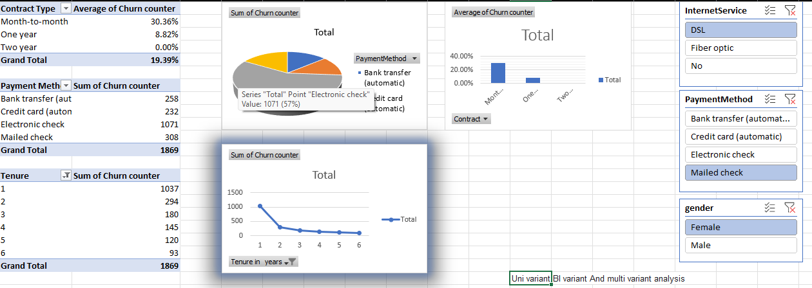
Project analysis slide 3
Creating Charts And Visuals
Excel
Excel: Pivot charts, conditional formatting for churn trends.

Slide 6
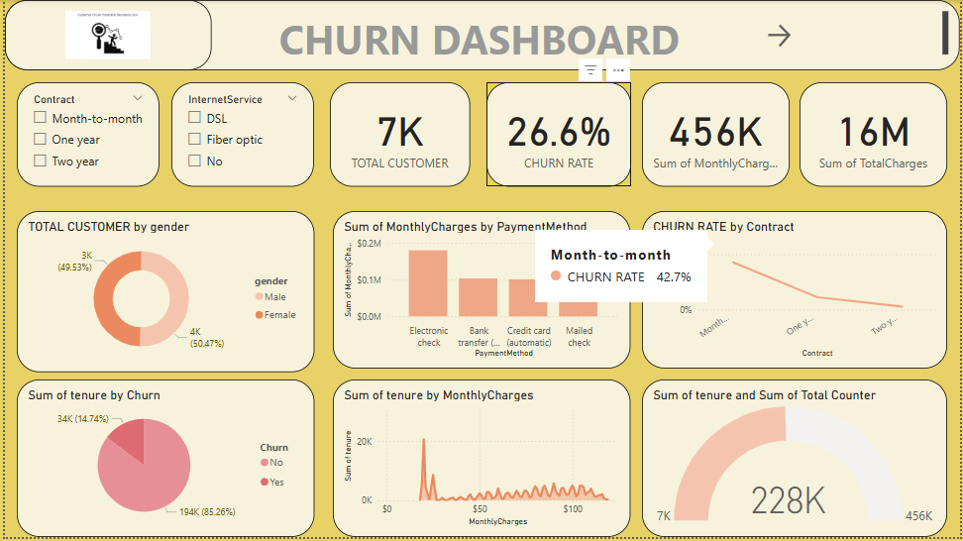
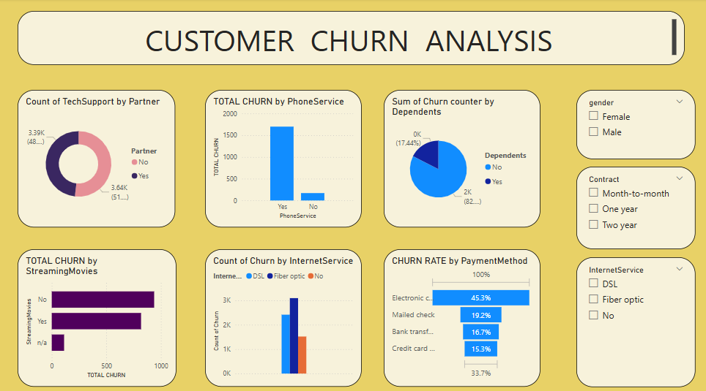
Creating Charts And Visuals
Power Bi
Power BI: Churn analysis by Power Bi using KPI cards, stacked bar charts, tree maps, line charts etc.

Slide 7
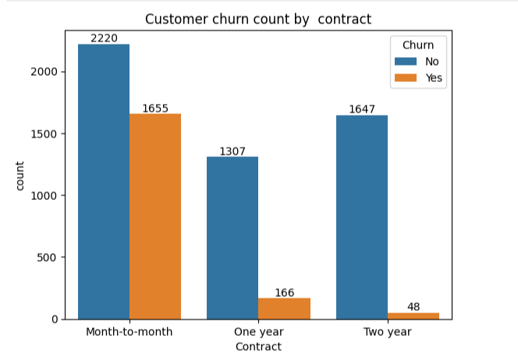
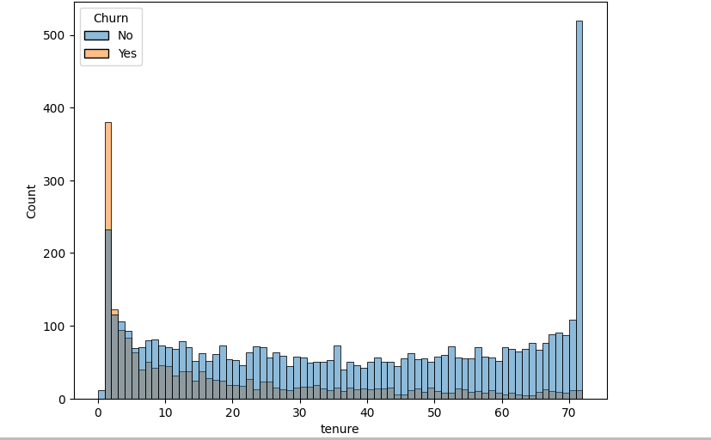
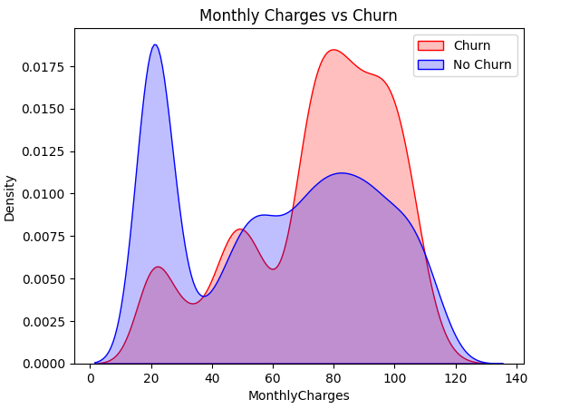
Creating Charts And Visuals
Python
Python: Matplotlib and Seaborn for data distribution, feature importance, correlation heatmap.

Slide 8
Project analysis slide 3
Conclusion
High Churn Rate (26.54%)
More than one-fourth of customers are leaving, which is a significant concern for business sustainability.
Key Factors Affecting Churn:
Contract Type: Month-to-month customers have the highest churn rate compared to those on yearly contracts.
Payment Method: Customers paying via electronic check show higher churn rates, possibly due to dissatisfaction with automated payments.
Tenure Impact: New customers (with tenure <6 months) are more likely to churn, indicating issues with onboarding or early engagement.
Higher Monthly Charges: Customers with higher monthly charges are more likely to churn, suggesting pricing sensitivity.
Recommendations to Reduce Churn:
Offer discounts or loyalty programs for long-term contracts to reduce month-to-month churn.
Improve customer onboarding and support within the first 6 months to increase retention.
Introduce alternative payment options to reduce reliance on electronic checks.
Provide customized plans or incentives for customers with high monthly charges.

Slide 9
Thank You

